Slide 2
Database Management Systems Lab Lab Instructor: Sami Ullah

Slide 3
Lab #1

Slide 4
Displaying Table Structure
Use the iSQL*Plus DESCRIBE command to display the structure of a table:
DESC[RIBE] tablename
Notes:
Displaying the Table Structure
In iSQL*Plus, you can display the structure of a table by using the DESCRIBE command. The command displays the column names and data types, and it shows you whether a column must contain data (that is, whether the column has a NOT NULL constraint).
In the syntax, tablename is the name of any existing table, view, or synonym that is accessible to the user.

Slide 5
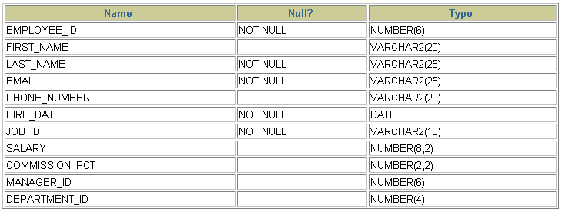
Displaying Table Structure
DESCRIBE employees
Notes:
Displaying the Table Structure (continued)
The example in the slide displays the information about the structure of the EMPLOYEES table.
In the resulting display, Null? indicates that the values for this column may be unknown. NOT NULL indicates that a column must contain data. Type displays the data type for a column.
The data types are described in the following table:

Slide 6
Objectives
After completing this lesson, you should be able to do the following:
List the capabilities of SQL SELECT statements
Execute a basic SELECT statement
Notes:
Objectives
To extract data from the database, you need to use the structured query language (SQL) SELECT statement. You may need to restrict the columns that are displayed. This lesson describes all the SQL statements that are needed to perform these actions. You may want to create SELECT statements that can be used more than once.
This lesson also covers the iSQL*Plus environment in which you execute SQL statements.

Slide 7
Basic SELECT Statement
SELECT *|{[DISTINCT] column|expression [alias],...}
FROM table;
SELECT identifies the columns to be displayed
FROM identifies the table containing those columns
Notes:
Basic SELECT Statement
In its simplest form, a SELECT statement must include the following:
A SELECT clause, which specifies the columns to be displayed
A FROM clause, which identifies the table containing the columns that are listed in the SELECT clause
In the syntax:
SELECT is a list of one or more columns
* selects all columns
DISTINCT suppresses duplicates
column|expression selects the named column or the expression
alias gives selected columns different headings
FROM table specifies the table containing the columns
Note: Throughout this course, the words keyword, clause, and statement are used as follows:
A keyword refers to an individual SQL element. For example, SELECT and FROM are keywords.
A clause is a part of a SQL statement. For example, SELECT employee_id, last_name, ... is a clause.
A statement is a combination of two or more clauses. For example, SELECT * FROM employees is a SQL statement.

Slide 8
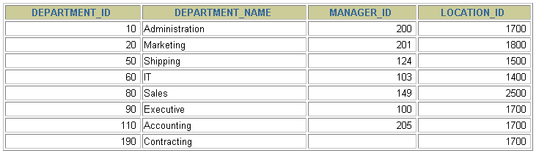
Selecting All Columns
SELECT *
FROM departments;
Notes:
Selecting All Columns of All Rows
You can display all columns of data in a table by following the SELECT keyword with an asterisk (*). In the example in the slide, the department table contains four columns: DEPARTMENT_ID, DEPARTMENT_NAME, MANAGER_ID, and LOCATION_ID. The table contains seven rows, one for each department.
You can also display all columns in the table by listing all the columns after the SELECT keyword. For example, the following SQL statement (like the example in the slide) displays all columns and all rows of the DEPARTMENTS table:
SELECT department_id, department_name, manager_id, location_id FROM departments;

Slide 9
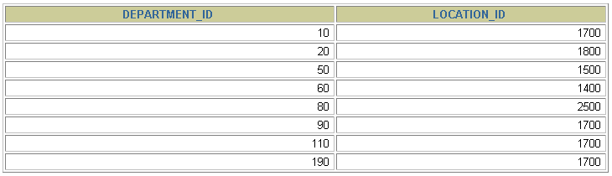
Selecting Specific Columns
SELECT department_id, location_id
FROM departments;
Notes:
Selecting Specific Columns of All Rows
You can use the SELECT statement to display specific columns of the table by specifying the column names, separated by commas. The example in the slide displays all the department numbers and location numbers from the DEPARTMENTS table.
In the SELECT clause, specify the columns that you want, in the order in which you want them to appear in the output. For example, to display location before department number going from left to right, you use the following statement:
SELECT location_id, department_id
FROM departments;

Slide 10
Writing SQL Statements
SQL statements are not case-sensitive.
SQL statements can be on one or more lines.
Keywords cannot be abbreviated or split across lines.
Clauses are usually placed on separate lines.
Indents are used to enhance readability.
In iSQL*Plus, SQL statements can optionally be terminated by a semicolon (;). Semicolons are required if you execute multiple SQL statements.
In SQL*plus, you are required to end each SQL statement with a semicolon (;).
Notes:
Writing SQL Statements
Using the following simple rules and guidelines, you can construct valid statements that are both easy to read and easy to edit:
SQL statements are not case-sensitive (unless indicated).
SQL statements can be entered on one or many lines.
• Keywords cannot be split across lines or abbreviated.
Clauses are usually placed on separate lines for readability and ease of editing.
• Indents should be used to make code more readable.
Keywords typically are entered in uppercase; all other words, such as table names and columns, are entered in lowercase.
Executing SQL Statements
Using iSQL*Plus, click the Execute button to run the command or commands in the editing window.
Using SQL*Plus, terminate the SQL statement with a semicolon and then press the Enter key to run the command.

Slide 11
Arithmetic Expressions
Create expressions with number and date data by using arithmetic operators.
Operator | Description
+ | Add
- | Subtract
* | Multiply
/ | Divide
Notes:
Arithmetic Expressions
You may need to modify the way in which data is displayed, or you may want to perform calculations or look at what-if scenarios. These are all possible using arithmetic expressions. An arithmetic expression can contain column names, constant numeric values, and the arithmetic operators.
Arithmetic Operators
The slide lists the arithmetic operators that are available in SQL. You can use arithmetic operators in any clause of a SQL statement (except the FROM clause).
Note: With DATE and TIMESTAMP data types, you can use the addition and subtraction operators only.

Slide 12
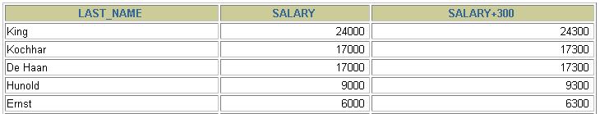
Using Arithmetic Operators
SELECT last_name, salary, salary + 300
FROM employees;
…
Notes:
Using Arithmetic Operators
The example in the slide uses the addition operator to calculate a salary increase of $300 for all employees. The slide also displays a SALARY+300 column in the output.
Note that the resultant calculated column SALARY+300 is not a new column in the EMPLOYEES table; it is for display only. By default, the name of a new column comes from the calculation that generated it—in this case, salary+300.
Note: The Oracle server ignores blank spaces before and after the arithmetic operator.
Operator Precedence
If an arithmetic expression contains more than one operator, multiplication and division are evaluated first. If operators in an expression are of the same priority, then evaluation is done from left to right.
You can use parentheses to force the expression that is enclosed by parentheses to be evaluated first.
Rules of Precedence:
Multiplication and division occur before addition and subtraction.
Operators of the same priority are evaluated from left to right.
Parentheses are used to override the default precedence or to clarify the statement.

Slide 13


Operator Precedence
SELECT last_name, salary, 12*salary+100
FROM employees;
1
…
SELECT last_name, salary, 12*(salary+100)
FROM employees;
2
…
Notes:
Operator Precedence (continued)
The first example in the slide displays the last name, salary, and annual compensation of employees. It calculates the annual compensation by multiplying the monthly salary by 12, plus a one-time bonus of $100. Notice that multiplication is performed before addition.
Note: Use parentheses to reinforce the standard order of precedence and to improve clarity. For example, the expression in the slide can be written as (12*salary)+100 with no change in the result.
Using Parentheses
You can override the rules of precedence by using parentheses to specify the desired order in which operators are to be executed.
The second example in the slide displays the last name, salary, and annual compensation of employees. It calculates the annual compensation as follows: adding a monthly bonus of $100 to the monthly salary, and then multiplying that subtotal by 12. Because of the parentheses, addition takes priority over multiplication.

Slide 14
Defining a Null Value
A null is a value that is unavailable, unassigned, unknown, or inapplicable.
A null is not the same as a zero or a blank space.
SELECT last_name, job_id, salary, commission_pct
FROM employees;
…
…
Notes:
Null Values
If a row lacks a data value for a particular column, that value is said to be null or to contain a null.
A null is a value that is unavailable, unassigned, unknown, or inapplicable. A null is not the same as a zero or a space. Zero is a number, and a space is a character.
Columns of any data type can contain nulls. However, some constraints (NOT NULL and PRIMARY KEY) prevent nulls from being used in the column.
In the COMMISSION_PCT column in the EMPLOYEES table, notice that only a sales manager or sales representative can earn a commission. Other employees are not entitled to earn commissions. A null represents that fact.

Slide 15
Null Values in Arithmetic Expressions
Arithmetic expressions containing a null value evaluate to null.
SELECT last_name, 12*salary*commission_pct
FROM employees;
…
…
Notes:
Null Values in Arithmetic Expressions
If any column value in an arithmetic expression is null, the result is null. For example, if you attempt to perform division by zero, you get an error. However, if you divide a number by null, the result is a null or unknown.
In the example in the slide, employee King does not get any commission. Because the COMMISSION_PCT column in the arithmetic expression is null, the result is null.
For more information, see “Basic Elements of SQL” in the SQL Reference.

Slide 16
Defining a Column Alias
A column alias:
Renames a column heading
Is useful with calculations
Immediately follows the column name (There can also be the optional AS keyword between the column name and alias.)
Requires double quotation marks if it contains spaces or special characters or if it is case-sensitive
Notes:
Column Aliases
When displaying the result of a query, iSQL*Plus normally uses the name of the selected column as the column heading. This heading may not be descriptive and hence may be difficult to understand. You can change a column heading by using a column alias.
Specify the alias after the column in the SELECT list using a space as a separator. By default, alias headings appear in uppercase. If the alias contains spaces or special characters (such as # or $), or if it is case-sensitive, enclose the alias in double quotation marks (" ").

Slide 17


Using Column Aliases
SELECT last_name AS name, commission_pct comm
FROM employees;
…
SELECT last_name "Name" , salary*12 "Annual Salary"
FROM employees;
…
Notes:
Column Aliases (continued)
The first example displays the names and the commission percentages of all the employees. Notice that the optional AS keyword has been used before the column alias name. The result of the query is the same whether the AS keyword is used or not. Also notice that the SQL statement has the column aliases, name and comm, in lowercase, whereas the result of the query displays the column headings in uppercase. As mentioned in a previous slide, column headings appear in uppercase by default.
The second example displays the last names and annual salaries of all the employees. Because Annual Salary contains a space, it has been enclosed in double quotation marks. Notice that the column heading in the output is exactly the same as the column alias.

Slide 18

Concatenation Operator
A concatenation operator:
Links columns or character strings to other columns
Is represented by two vertical bars (||)
Creates a resultant column that is a character expression
SELECT last_name||job_id AS "Employees"
FROM employees;
…
Notes:
Concatenation Operator
You can link columns to other columns, arithmetic expressions, or constant values to create a character expression by using the concatenation operator (||). Columns on either side of the operator are combined to make a single output column.
In the example, LAST_NAME and JOB_ID are concatenated, and they are given the alias Employees. Notice that the employee last name and job code are combined to make a single output column.
The AS keyword before the alias name makes the SELECT clause easier to read.
Null Values with the Concatenation Operator
If you concatenate a null value with a character string, the result is a character string. LAST_NAME || NULL results in LAST_NAME.

Slide 19
Literal Character Strings
A literal is a character, a number, or a date that is included in the SELECT statement.
Date and character literal values must be enclosed by single quotation marks.
Each character string is output once for each row returned.
Notes:
Literal Character Strings
A literal is a character, a number, or a date that is included in the SELECT list and that is not a column name or a column alias. It is printed for each row returned. Literal strings of free-format text can be included in the query result and are treated the same as a column in the SELECT list.
Date and character literals must be enclosed by single quotation marks (' '); number literals need not be so enclosed.

Slide 20
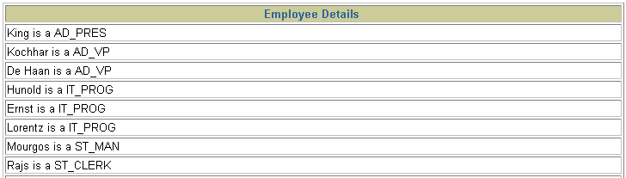
Using Literal Character Strings
SELECT last_name ||' is a '||job_id
AS "Employee Details"
FROM employees;
…
Notes:
Literal Character Strings (continued)
The example in the slide displays last names and job codes of all employees. The column has the heading Employee Details. Notice the spaces between the single quotation marks in the SELECT statement. The spaces improve the readability of the output.
In the following example, the last name and salary for each employee are concatenated with a literal to give the returned rows more meaning:
SELECT last_name ||': 1 Month salary = '||salary Monthly
FROM employees;

Slide 21

Alternative Quote (q) Operator
Specify your own quotation mark delimiter
Choose any delimiter
Increase readability and usability
SELECT department_name ||
q'[, it's assigned Manager Id: ]'
|| manager_id
AS "Department and Manager"
FROM departments;
…
Notes:
Alternative Quote (q) Operator
Many SQL statements use character literals in expressions or conditions. If the literal itself contains a single quotation mark, you can use the quote (q) operator and choose your own quotation mark delimiter.
You can choose any convenient delimiter, single-byte or multibyte, or any of the following character pairs: [ ], { }, ( ), or < >.
In the example shown, the string contains a single quotation mark, which is normally interpreted as a delimiter of a character string. By using the q operator, however, the brackets [] are used as the quotation mark delimiter. The string between the brackets delimiters is interpreted as a literal character string.

Slide 22


Duplicate Rows
The default display of queries is all rows, including duplicate rows.
SELECT department_id
FROM employees;
1
…
SELECT DISTINCT department_id
FROM employees;
2
…
Notes:
Duplicate Rows
Unless you indicate otherwise, iSQL*Plus displays the results of a query without eliminating duplicate rows. The first example in the slide displays all the department numbers from the EMPLOYEES table. Notice that the department numbers are repeated.
To eliminate duplicate rows in the result, include the DISTINCT keyword in the SELECT clause immediately after the SELECT keyword. In the second example in the slide, the EMPLOYEES table actually contains 20 rows, but there are only seven unique department numbers in the table.
You can specify multiple columns after the DISTINCT qualifier. The DISTINCT qualifier affects all the selected columns, and the result is every distinct combination of the columns.
SELECT DISTINCT department_id, job_id
FROM employees;

Slide 23
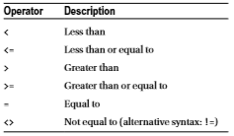
WHERE Clause

Slide 24
Example
select ename, init, msal from employees
where msal >= 3000;
select dname, location from departments
where location <> 'CHICAGO';

Slide 25
Lab #2

Slide 26
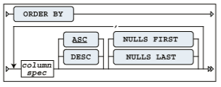
ORDER BY Clause

Slide 27
Example
select ename, 12*msal+comm as yearsal
from employees
where job = 'SALESREP'
order by yearsal desc;

Slide 28
Logical Operators
Operator
AND OR
NOT
Meaning
Returns TRUE if both component conditions are TRUE
Returns TRUE if either component condition is TRUE
Returns TRUE if the following condition is FALSE
Notes:
Logical Operators
A logical operator combines the result of two component conditions to produce a single result based on them or to invert the result of a single condition. Three logical operators are available in SQL:
AND
OR
NOT
All the examples so far have specified only one condition in the WHERE clause. You can use several conditions in one WHERE clause using the AND and OR operators.

Slide 29
Using the AND Operator
AND requires both conditions to be TRUE
SQL> SELECT empno, ename, job, sal
2 FROM emp
3 WHERE sal>=1100
4 AND job='CLERK';
EMPNO ENAME JOB SAL
--------- ---------- --------- ---------
7876 ADAMS CLERK 1100
7934 MILLER CLERK 1300
Notes:
The AND Operator
In the example, both conditions must be true for any record to be selected. Therefore, an employee who has a job title of CLERK and earns more than $1100 will be selected.
All character searches are case sensitive. No rows are returned if CLERK is not in uppercase. Character strings must be enclosed in quotation marks.
AND Truth Table
The following table shows the results of combining two expressions with AND:
Class Management Note
Demo: l2and.sql
Purpose: To illustrate using the AND operator.

Slide 30
Using the OR Operator
OR requires either condition to be TRUE
SQL> SELECT empno, ename, job, sal
2 FROM emp
3 WHERE sal>=1100
4 OR job='CLERK';
EMPNO ENAME JOB SAL
--------- ---------- --------- ---------
7839 KING PRESIDENT 5000
7698 BLAKE MANAGER 2850
7782 CLARK MANAGER 2450
7566 JONES MANAGER 2975
7654 MARTIN SALESMAN 1250
...
7900 JAMES CLERK 950
...
14 rows selected.
Notes:
The OR Operator
In the example, either condition can be true for any record to be selected. Therefore, an employee who has a job title of CLERK or earns more than $1100 will be selected.
The OR Truth Table
The following table shows the results of combining two expressions with OR:
Class Management Note
Demo: l2or.sql
Purpose: To illustrate using the OR operator.

Slide 31
Using the NOT Operator
SQL> SELECT ename, job
2 FROM emp
3 WHERE job NOT IN ('CLERK','MANAGER','ANALYST');
ENAME JOB
---------- ---------
KING PRESIDENT
MARTIN SALESMAN
ALLEN SALESMAN
TURNER SALESMAN
WARD SALESMAN
Notes:
The NOT Operator
The slide example displays name and job title of all the employees whose job title is not CLERK, MANAGER, or ANALYST.
The NOT Truth Table
The following table shows the result of applying the NOT operator to a condition:
Note: The NOT operator can also be used with other SQL operators, such as BETWEEN, LIKE, and NULL.
... WHERE NOT job IN ('CLERK', 'ANALYST')
... WHERE sal NOT BETWEEN 1000 AND 1500
... WHERE ename NOT LIKE '%A%'
... WHERE comm IS NOT NULL

Slide 32
Rules of Precedence
Order Evaluated Operator
1 All comparison operators
2 NOT
3 AND
4 OR
Override rules of precedence by using parentheses

Slide 33
Rules of Precedence
SQL> SELECT ename, job, sal
2 FROM emp
3 WHERE job='SALESMAN'
4 OR job='PRESIDENT'
5 AND sal>1500;
ENAME JOB SAL
---------- --------- ---------
KING PRESIDENT 5000
MARTIN SALESMAN 1250
ALLEN SALESMAN 1600
TURNER SALESMAN 1500
WARD SALESMAN 1250
Notes:
Example of Precedence of AND Operator
In the slide example, there are two conditions:
The first condition is that job is PRESIDENT and salary is greater than 1500.
The second condition is that job is SALESMAN.
Therefore, the SELECT statement reads as follows:
“Select the row if an employee is a PRESIDENT and earns more than $1500 or if the employee is a SALESMAN.”
Class Management Note
Demo: l2sal1.sql
Purpose: To illustrate the rules of precedence.

Slide 34
Rules of Precedence
SQL> SELECT ename, job, sal
2 FROM emp
3 WHERE (job='SALESMAN'
4 OR job='PRESIDENT')
5 AND sal>1500;
ENAME JOB SAL
---------- --------- ---------
KING PRESIDENT 5000
ALLEN SALESMAN 1600
Notes:
Using Parentheses
In the example, there are two conditions:
The first condition is that job is PRESIDENT or SALESMAN.
The second condition is that salary is greater than 1500.
Therefore, the SELECT statement reads as follows:
“Select the row if an employee is a PRESIDENT or a SALESMAN and if the employee earns more than $1500.”
Class Management Note
Demo: l2sal2.sql
Purpose: To illustrate the rules of precedence.

Slide 35
BETWEEN , IN and LIKE
The BETWEEN operator does not open up new possibilities; it only allows you to formulate certain conditions a bit more easily and more readably.
select ename, init, msal
from employees where msal between 1300 and 1600

Slide 36
IN Operator
With the IN operator, you can compare a column or the outcome of a column expression against a list of values. Using the IN operator is also a simpler way of writing a series of OR conditions. Instead of writing empno = 7499 OR empno = 7566 OR empno = 7788, you simply use an IN-list
select empno, ename, init
from employees
where empno in (7499,7566,7788);

Slide 37
NOT Operator
select * from registrations
where evaluation
NOT IN (3,4,5);

Slide 38
The LIKE Operator
You typically use the LIKE operator in the WHERE clause of your queries in combination with a search pattern
select * from emp
where ename
LIKE '%R%';

Slide 39
The IS NULL Operator
select empno, ename, comm
from employees
where comm <= 400
Or
comm is null;
select ename, job, msal,
comm from employees
where comm is not null;

